Slide 1
Vacat E-Commerce Analysis Project
By
Motunrayo Akinsanya

Slide 2
Background
Vacat is an e-commerce company that currently manages its data in a silo which makes it impossible to analyze data accurately and to track and monitor KPIs efficiently. To resolve this problem, Mirad Solutions was recruited to aggregate the data from disparate sources into a centralized platform. This centralized platform will be the only data source for analyzing, tracking, and monitoring KPI metrics.

Slide 3
Problem
Data Silo: Vacat’s current data sources are PostgreSQL, Salesforce, and ERP systems. These sources are independent of each other making data inaccuracy and duplication a threat.
No insight from data: Because of the disparate data sources, Vacat is unable to generate real-time insight data, making it difficult to drive growth via informed decision-making.

Slide 4
Analysis Goal
To resolve the data silo problem, we will;
Create a new relational database for Vacat’s data
Create a table for each dataset in the database
Extract the data from their current source, clean them, and load them into the database
Make the database the centralized source for data by ensuring all new data added to the old data sources are automatically updated into the new relational database.

Slide 5
Analysis Goal
To perform data analysis to generate insight from data, and track and monitor KPI metrics, we will;
Write SQL queries to extract all required columns and tables in the relational database
Transform the extracted data with Power Query
Load the transformed data into PowerBi
Build a data model for efficient data analysis and create relationships among the tables.

Slide 6
Analysis Goal
Create primary and secondary metrics by applying statistical calculations using DAX functions.
Perform exploratory data analysis to identify trends, patterns, and relationships, and forecast future sales.
Create visualization from insights generated from the data analysis.
Develop an interactive dashboard that shows the summary of all KPIs, product analysis, customer analysis, order analysis, and sales analysis

Slide 7
Executive Summary
From January 2015 to December 2017, Vacat recorded total sales of approximately $1.8M, 4040 total orders, a gross profit of roughly $236,900, and an average profit margin of 12%.
The total count of customers stood at 8001, the total quantity of products ordered was 30000, and the average discount on sales was 16%.

Slide 8
Insights

Slide 9
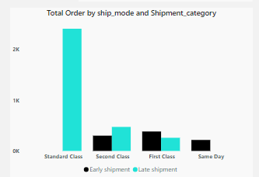
Order Analysis Insight
Of the 4040 counts of orders, 22% were fulfilled via early shipment while 78% were shipped late. (For this analysis, an early shipment is defined as a shipment made 2 or fewer days after the order date).
All standard class orders were shipped late.

Slide 10
Order Analysis Insight
All same-day orders were shipped early.
Ship mode for 60% of the total order was Standard Class while 5% were Same Day.
60% of the first class orders were shipped late while 61% of second class orders were shipped late.

Slide 11
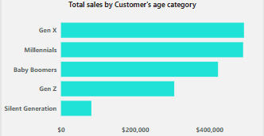
Customer Analysis Insight
The total count of customers was 8001. 55% of the population are Millennials and Gen X while silent generation made up less than 5%.
29% of the orders were made by millennials, generating the highest sales among the age category.

Slide 12
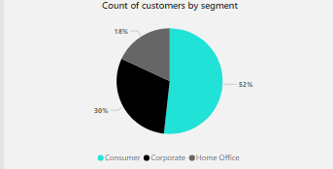
Customer Analysis Insight
California has the highest count of customers at 127, and Oklahoma and Nevada have the lowest count of customers at 1 each.
52% of the customers fall under the consumer segment, 30% Corporate, and 18% Home office.

Slide 13
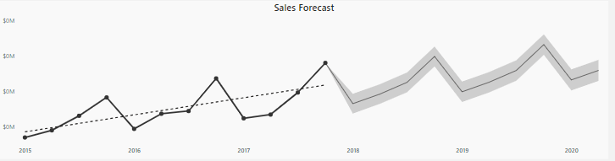
Sales Analysis and Forecast Insight
The 2018 sales forecast predicts a sales drop to $164,700.71 in Q1, a rise to $191,723.34 in Q2, a rise to $225,051.33 in Q3, and a rise to $298,367.79 in Q4.
The year-on-year change in sales for 2016 was 29% and 20% for 2017.

Slide 14
Sales Analysis and Forecast Insight
The Central region had the highest average profit margin at 14%, while the South region had the lowest at 7%.
The drop in sales in Q1 of 2016 and Q2 of 2017 was a result of a 60% and 29% drop in the quantity of products ordered

Slide 15
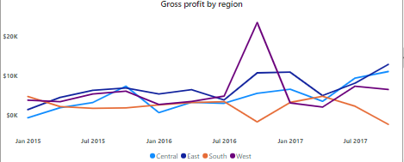
Product Analysis Insight
Copiers have the highest profit margin of 38% while Tables, Bookcases, and Supplies have a negative average profit margin of negative (6.4)%.
Tables were sold at a loss in all regions though it recorded a high sales of $160,877.

Slide 16
Product Analysis Insight
Bookcases were sold at a loss in all regions except the Central region which recorded a gross profit of $690.
Supplies were also sold at a loss in all regions except for the East region which recorded a gross profit of $79.
Chairs had the highest sales, making up 13.8% of the total sales.

Slide 17
Product Analysis Insight
.
Binders are the most ordered product with a total count of 1043 orders.
Product category- Technology accounted for 36.4% of the total sales, followed by furniture at 32.3% and office supplies at 31.3%

Slide 18
Recommendations
Sales of Product Sub-category tables, bookcases, and supplies should be reviewed for profitability in all regions.
The drop in sales in Q1 of 2016 and Q2 of 2017 was a result of a drop in the quantity of products ordered. This drop in quantity was experienced in all regions. The cause should investigated, the promotional campaigns for all products should increase and measures put in place to prevent reoccurrence.

Slide 19
Recommendations
Since millennials and Gen X make up a high proportion of the customers, thereby contributing more towards sales and profit, marketing activities should be targeted towards this age group to promote customer retention and attract more customers.
All first-class orders should be shipped early to promote fast delivery and enhance customer satisfaction.
More same-day delivery options should be offered to customers.

